Slide 1
Introduction to Computing
Using Java
File and I/O
2019 File IO
Michael Fung, CS&E, The Chinese University of HK

Slide 2
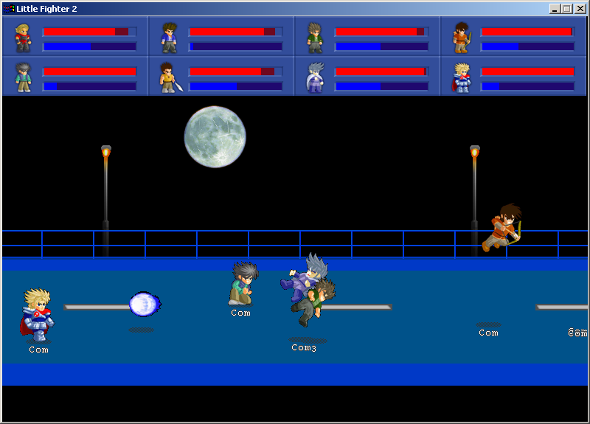
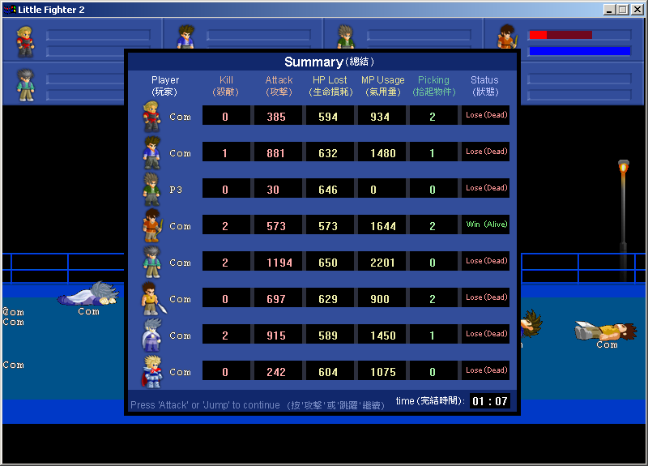
High Score Table of lf2
2019 File IO
Michael Fung, CS&E, The Chinese University of HK

Slide 3
Keep Information Non-volatile
Modern computers are electronic.
Without power supply → Data Loss!
To keep data non-volatile, save it to a file!
2019 File IO
Michael Fung, CS&E, The Chinese University of HK

Slide 4
Retrieve Information
Data on a file cannot be processed by a computer program directly.
We have to load it from the file.
Moreover, we don’t want to be typists who repeat the same data input every time.
2019 File IO
Michael Fung, CS&E, The Chinese University of HK

Slide 5
Background Information
How does System.out.println() work?
System is a class, what about System.out?
Why TWO dots?
2019 File IO
Michael Fung, CS&E, The Chinese University of HK

Slide 6
Talk About Printing
Before talking about input from keyboard,
let’s first consider output to screen in Java.
System.out.print() is a familiar message.
System is a class. Just like Account.
System has some fields, one of which is
  PrintStream out
  out is an object reference to an object of class PrintStream
  We further send a print() message to out
2019 File IO
Michael Fung, CS&E, The Chinese University of HK

Slide 7
Imagine...How Might It Look Like in Java?
class System
{
// public class fields
public static PrintStream out;
public static InputStream in;
// private class field example
private static String computerName;
// private instance field example
private long memoryAvailable;
...
}
2019 File IO
Michael Fung, CS&E, The Chinese University of HK

Slide 8
The Picture
System.out.print()
System
PrintStream
PrintStream
out

print( )
print( )
in
println( )
println( )
System.out is a PrintStream object reference.
We then send a print() message to this object.
InputStream
InputStream
…
…
…
…
2019 File IO
Michael Fung, CS&E, The Chinese University of HK

Slide 9
File and Input/Output Operations
There are classes to represent a file on disk, a file in network, or input/ output from console.
They provide methods to make file and IO operations more convenient.
Class PrintStream and Class Scanner
2019 File IO
Michael Fung, CS&E, The Chinese University of HK

Slide 10
Class PrintStream
import java.io.*;
...main(...) throws IOException
{
PrintStream myNewFile;
myNewFile = new PrintStream("myWeb.txt");
myNewFile.println("Hello World in a file!");
System.out.println("Hello World on screen.");
// myNewFile is a PrintStream object reference
// System.out is a PrintStream object reference
}
2019 File IO
Michael Fung, CS&E, The Chinese University of HK

Slide 11
PrintStream Object References
PrintStream anObjectRef;
anObjectRef = System.out;
anObjectRef.println("Say Hello to screen!");
anObjectRef = new PrintStream("myWeb.txt");
anObjectRef.println("Say Hello to a file!");
// anObjectRef is a variable. At different time,
// it refers to different PrintStream objects:
//
// System.out is a PrintStream object
// new PrintStream() creates another object
2019 File IO
Michael Fung, CS&E, The Chinese University of HK

Slide 12
PrintStream Object References
PrintStream anObjectRef;
anObjectRef = System.out;
anObjectRef.println("Say Hello to screen! ");
PrintStream myNewFile;
myNewFile = new PrintStream("myWeb.txt");
anObjectRef = myNewFile;
anObjectRef.println("Say Hello to a file! ");
// we can copy object references
// anObjectRef.println will print differently
2019 File IO
Michael Fung, CS&E, The Chinese University of HK

Slide 13
Class Scanner
import java.util.*;
import java.io.*;
...main(...) throws Exception
{
Scanner markFile;
markFile = new Scanner(new File("myWeb.txt"));
int mark;
if (markFile.hasNextInt())
mark = markFile.nextInt();
}
2019 File IO
Michael Fung, CS&E, The Chinese University of HK

Slide 14
Class Scanner
The methods hasNextInt(), hasNextDouble(), hasNextXyz()… return us a boolean (true/ false) value that indicates if there is more data to read from the Scanner object.
The methods nextInt(), nextDouble(), … reads a piece of data from the source for us.
Operations may fail, thus we add
“throws Exception” to the main() method.
2019 File IO
Michael Fung, CS&E, The Chinese University of HK

Slide 15
Class Scanner: line-by-line
import java.util.*;
import java.io.*;
...main(...) throws Exception
{
Scanner markFile;
markFile = new Scanner(new File("myWeb.txt"));
String aLine;
while (markFile.hasNextLine())
{
aLine = markFile.nextLine();
System.out.println(aLine);
}
}
2019 File IO
Michael Fung, CS&E, The Chinese University of HK

Slide 16
Class Scanner: line-by-line
The method nextLine() reads a line from the source for us. It returns a String.
The source for the Scanner object could be
the keyboard, a file, a web source.
System.in is a field in class System.
It refers to a default InputStream object, representing the keyboard.
2019 File IO
Michael Fung, CS&E, The Chinese University of HK

Slide 17
Class Scanner
The source could be
  the keyboard object
    new Scanner( System.in );
  a file object
    new Scanner( new File(“filename”) );
  a web source
    new Scanner(new URL(“http://...”).openStream( ) );
2019 File IO
Michael Fung, CS&E, The Chinese University of HK

Slide 18
End Note
Readings and References
  Section 2.6 The Scanner class from Java
2019 File IO
Michael Fung, CS&E, The Chinese University of HK

